Slide 1
Lesson Six
Design and layout of food premises

Slide 2
Discuss
Imagine you’re designing a kitchen. What do you need to think about?

Slide 3
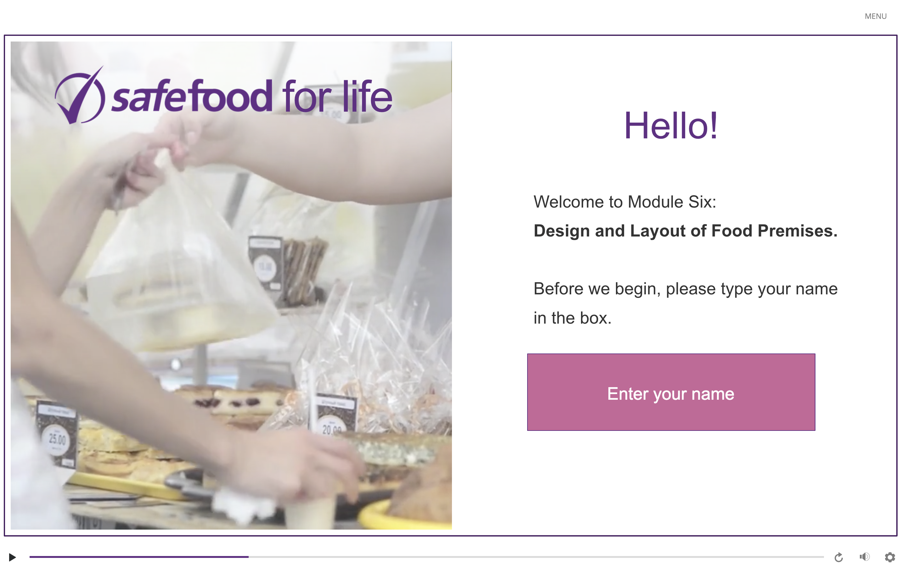
eLearning module

Slide 4
In class task
Evaluate the structure of the laboratory/kitchen you are in for class, considering the composition and structure of:
Walls
Floors
Ceiling
Windows
Doors
Notes:
Divide the class into groups of 2 or 3 students.
Ask the students to make a descriptive list of the composition and structure of the walls, floors, ceiling, windows and doors.
Ask each group to begin with a different area and then to rotate until they have covered each area of the room.
The students should evaluate each area under the headings provided on the slide.
For example, for windows students could evaluate:
Are they closing properly and easy to open?
Do they help prevent condensation?
Are they in good condition or are they rotten in places?
Is it easy to clean them and keep them clean?

Slide 5
Homework task
Write a paragraph about each of the service requirements:
Ventilation: Describe the ventilation in your home.
Water: Explain why you shouldn’t drink water from taps upstairs at home. You may need to do some research.
Drainage: Describe what a grease trap is. You may need to do some research.
Refuse storage and disposal: List at least five ways to reduce the amount of rubbish at home or at school.

